Slide 1

Accident Avoidance & Detection System
GUIDE
Dr.T.VIJAY ANANTH,
Assistant Professor (ECE)
TEAM MEMBERS
Arafathali M
Jeevananthan S K
Daison Manickam A

Slide 2
INTRODUCTION:
The development of a transportation system has been the generative power for human beings to have the highest civilization above creatures in the earth.
Automobile has a great importance in our daily life.
In 2020, 38,080 people died in vehicle traffic crashes only in India for Lockdown Period.
So in this project easily to avoid the accident. Suppose the vehicle are crashed detect the location for rescuing the people.

Slide 3
PROBLEM STATEMENT
1.3 million people die each year as a result of road traffic accidents and no-one helps you after a car crashed at any places. So in this project,
Avoid the accident using ultrasonic distance & smoke sensor.
Detect the accident and alert in sms of google map location and accident of time to your home, hospital or etc…

Slide 4
MAIN OBJECTIVE:
Over 70% of accidents can be avoided. So main objective in this project,
Reduce the count of Accidents.
Rescuing people in accidents.
Hereafter no accidents in globally.
They get the minor injury, But they should not go alive.

Slide 5
METHODOLOGY
In the accident avoid system, using Accelerometer namely ADXL335 is used for detecting accident or sudden change in any axis. GPS Receiver is used for detecting coordinates of the vehicle, GSM module is used for sending the alert SMS with the coordinates and the link to Google Map.
Ultrasonic sensor sense the opposite any vehicle or objects then the DC motor turn Anticlockwise direction in 4 seconds only.
Smoke sensor sense the smoke then the DC motor is stopped.

Slide 6
LITERATURE SURVEY
Name | Publisher | Year of Publication | Authors | Abstract
IOT Based Automatic Vehicle Accident Alert System | IEEE | 2020 | Aleem ali, asif ali, Nazia Parveen | accelerometer if the values of x, y and z parameters are extra than the defined values than it 's going to set situation to proper and the code written for initiating the intimation and SMS alert gets executed.
Microcontroller based Intelligent Braking System in Electric Scooters | IEEE | 2020 | Deepak Praveen, Hemanth kumar, Raja Sree | the use of ultrasonic sensors, it appropriately detects the fast approaching obstacles in front of the scooter. Continually, the received signals are used by the microcontroller to proceed the further braking action.

Slide 7
COMPONENTS REQUIRED
Arduino UNO
GPS Module (U-blox 6m NEO)
Triple axis Accelerometer (ADXL345)
Sim800 Quad Band GSM/GPRS
Ultrasonic Sensor (HC-SR04)
DC Motor (5V)
Gas Sensor (MQ-2)
Arduino IDE (Software)

Slide 8
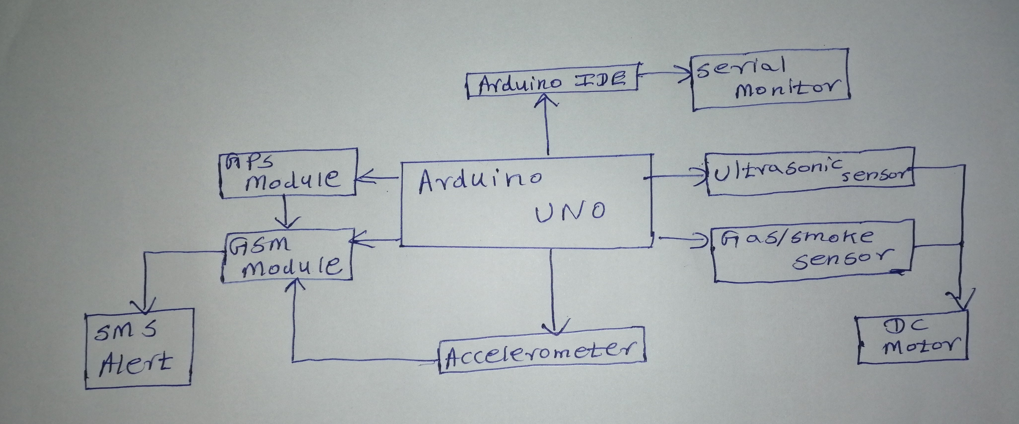
BLOCK DIAGRAM:

Slide 9
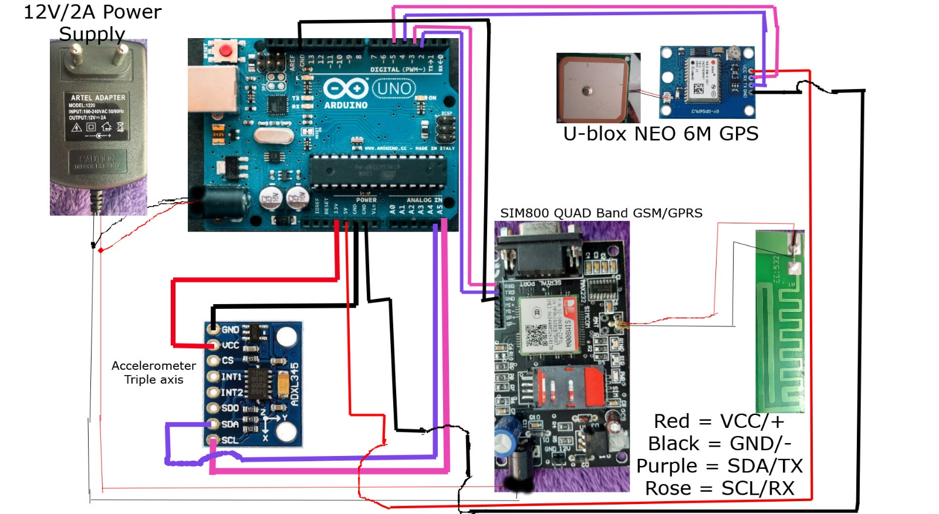
CIRCUIT DIAGRAM

Slide 10
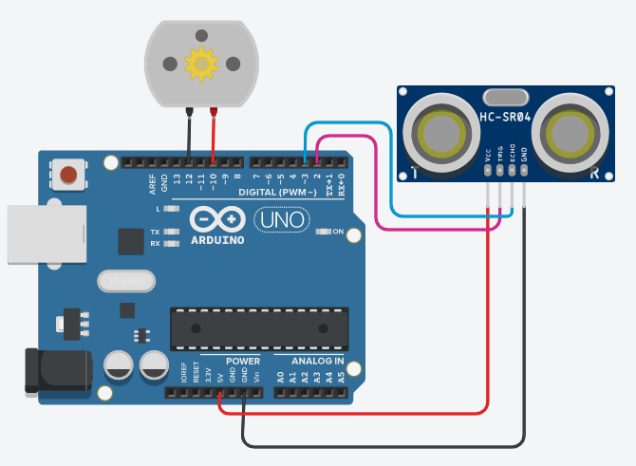
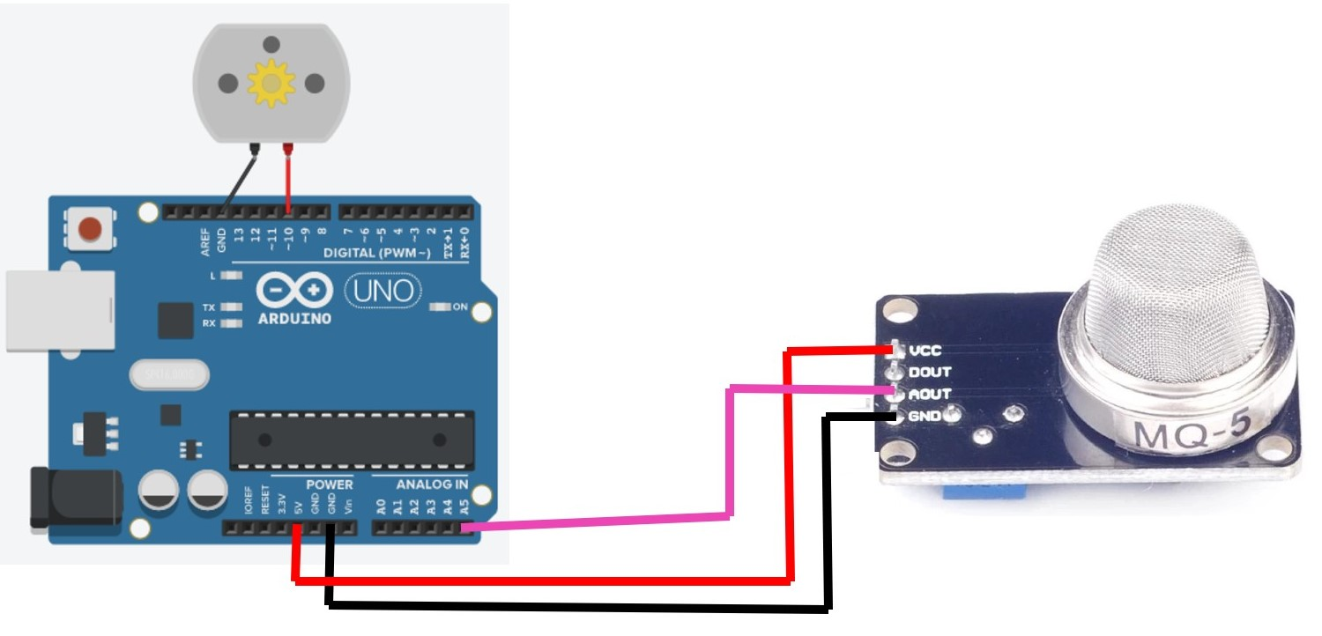
CIRCUIT DIAGRAM:

Slide 11
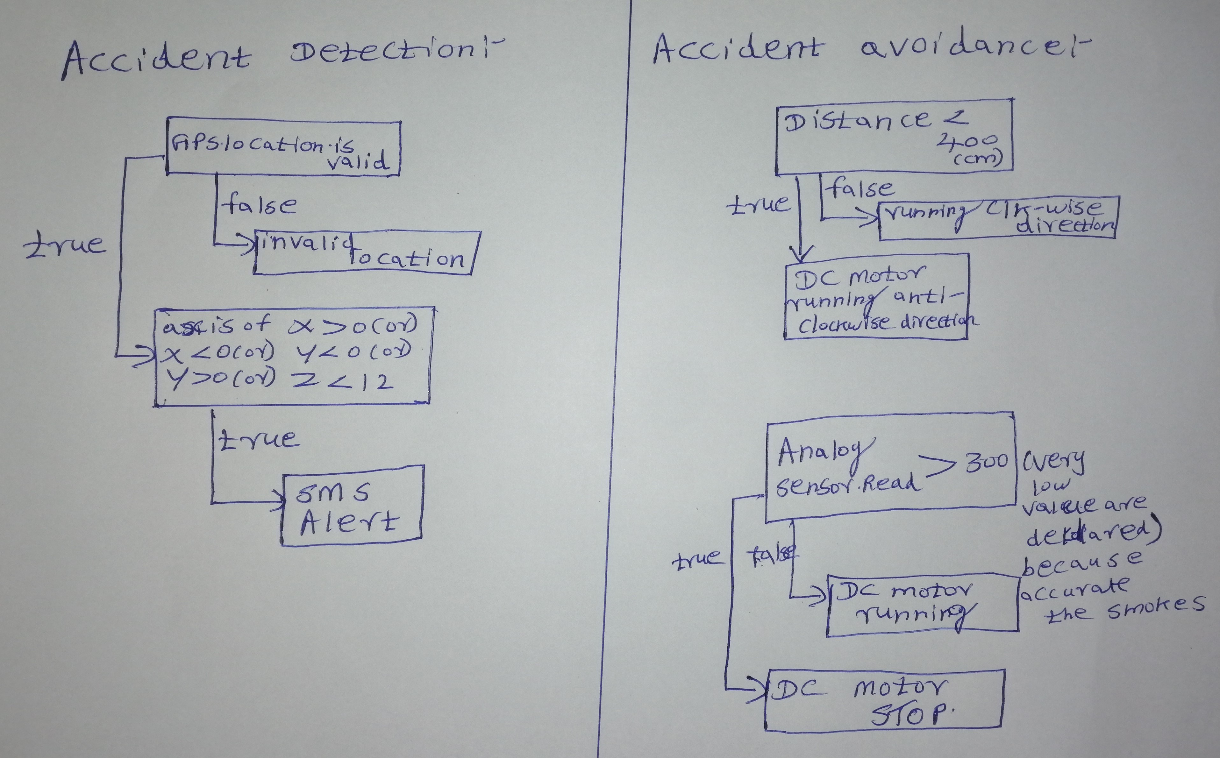
FLOW CHART:

Slide 12
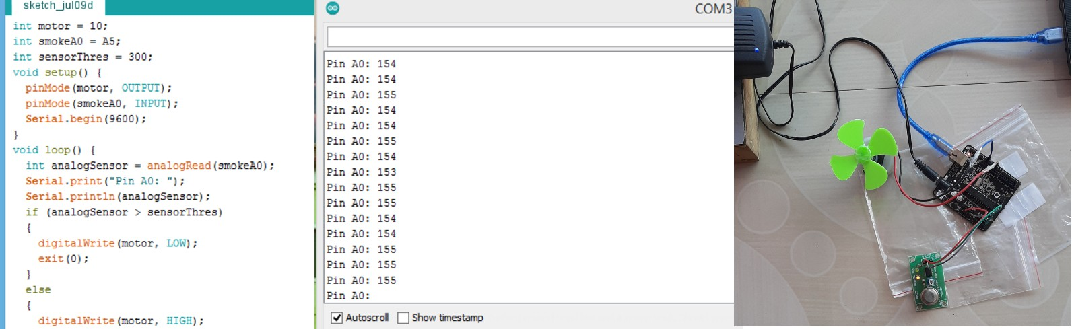
RESULT:

Slide 13
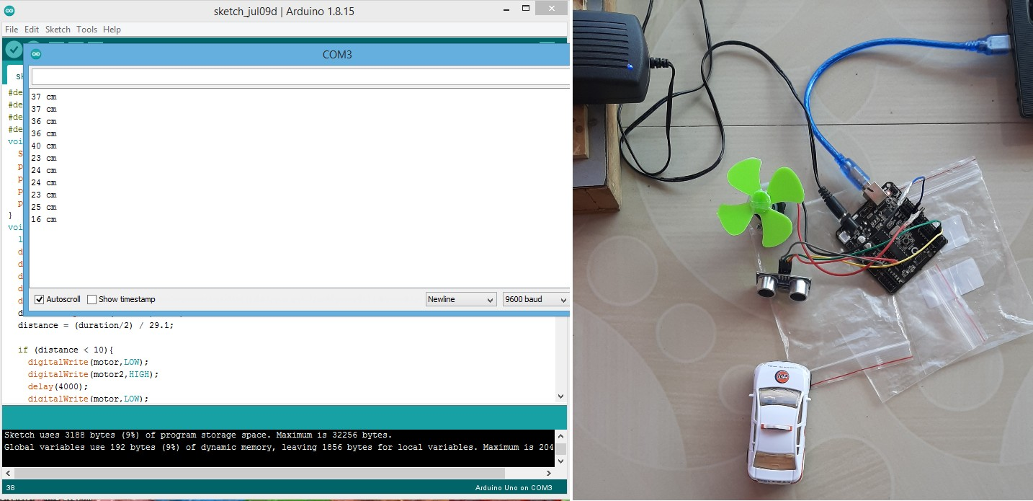

Slide 14
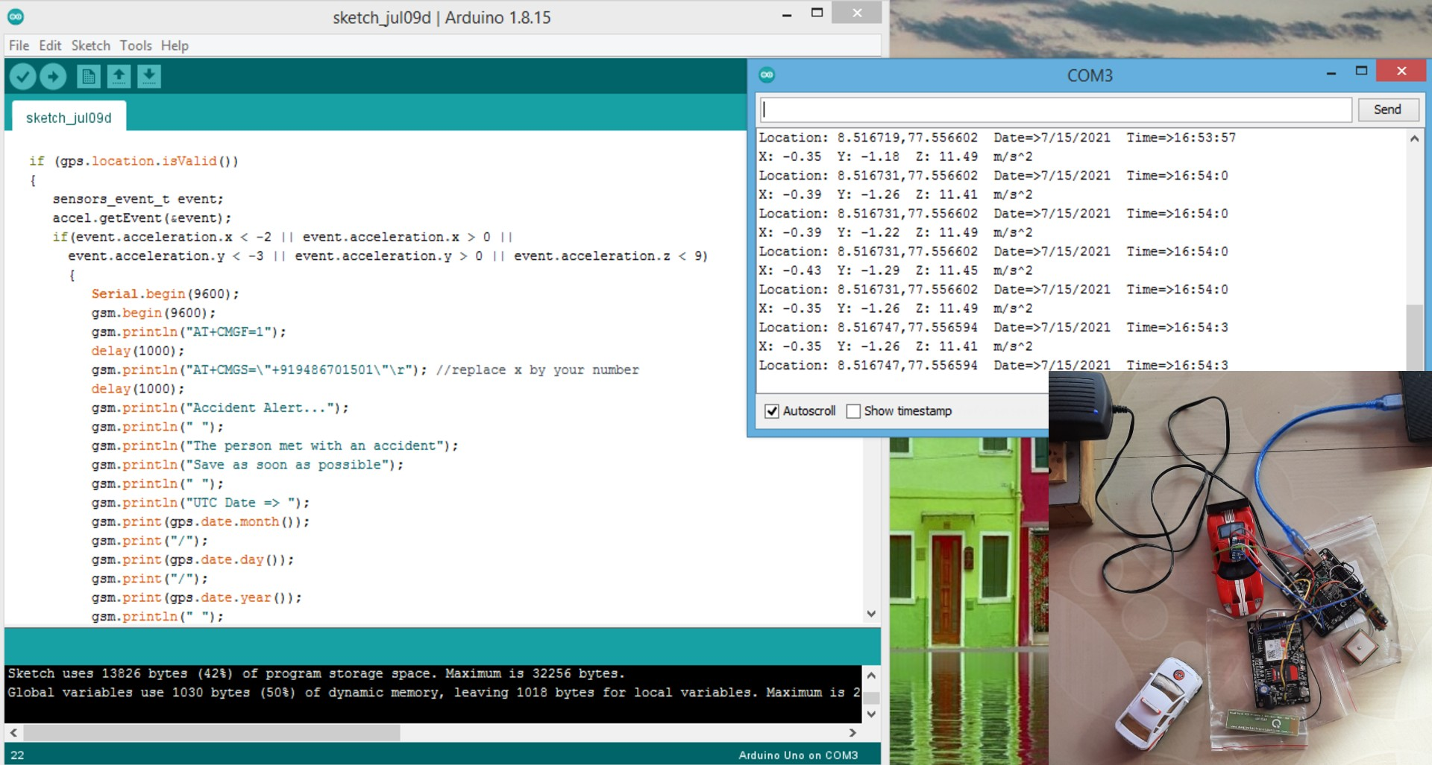

Slide 15
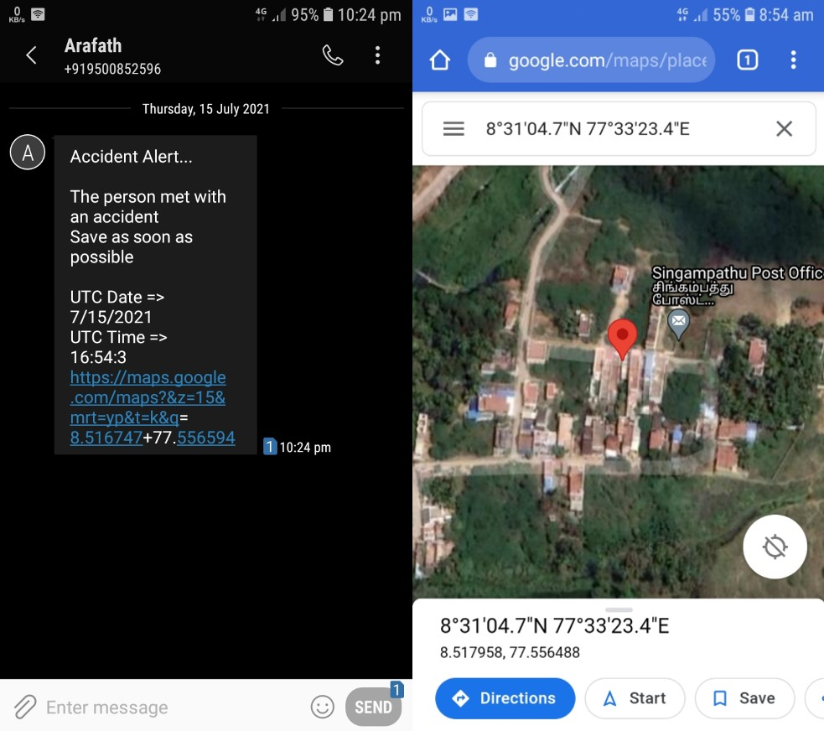
https://youtu.be/7zF_SymW2OM
https://youtu.be/t18B1AMP1U8

Slide 16
COST ESTIMATION
Arduino Uno = 780₹
GSM Module (SIM800 Quad Band) = 1,100₹
GPS Module (U-Blox NEO-6M) = 900₹
Accelerometer (ADXL345) = 200₹
Power supply 12v 2amp = 270₹
Ultrasonic (HC-SR04) = 180₹
Smoke Sensor (MQ-2) = 250₹
Others = 550₹
Total = 4230₹

Slide 17
FUTURE SCOPE:
The proposed system deals with the avoidance and detection of the accidents. But this can be extended by providing medication to the victims at the accident spot.
By increasing the technology we can also avoid accidents by providing alerts systems that can stop the vehicle to overcome the accidents.
So definitely we are develop in this project in future using image processing or other techniques.

Slide 18
CONCLUSION:
The proposed system deals with the accident avoidance and detection. Arduino is the heart of the system which helps in transferring the message to different devices in the system.
Accelerometer sensor will be activated when the accident occurs and the information is transferred to the registered number through GSM module.
Using GPS the location can be sent through tracking system to cover the geographical coordinates over the area. The accident can be detected by an accelerometer sensor.
In this accident avoidance methods is mostly save the human life, at least causing physical damage not causing damage of Life.

Slide 19
REFERENCES:
C. Thompson, J. White, B. Dougherty, A. Albright, and D. C. Schmidt, "Using Smart phones to Detect Car Accidents and Provide Situational Awareness to Emergency Responders," in 3rd International ICST Conference on MOBILE Wireless MiddleWARE, Operating Systems, and Applications (Mobilware 2018), 2018.
“Vehicle Accident Detection And Reporting System Using Gps And Gsm.” by AboliRavindraWakure, ApurvaRajendraPatkar, IJERGS April 2014.
D. A. Whitney and J. J. Pisano TASC, Inc., Reading, Massachusetts, "Auto Alert: Automated Acoustic Detection of Incidents", IDEA project, [Online]. Accessed on 15 October 2011, Available: http://pubsindex.trb.org/view.aspx?id=481489
Ollis, M.HERMAN.H. & SINGH.S, “Analysis and design panaromic stereo vision using equi-angular pixel cameras”, technical report, Carnegie Mellon Robotics university, 1999.

Slide 20
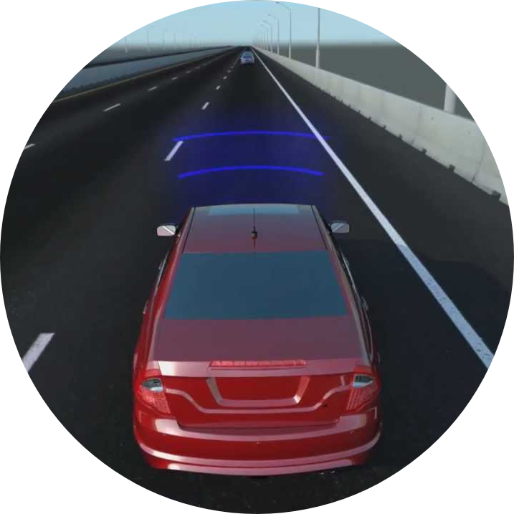
THANK YOU Any Queries?

